Slide 1
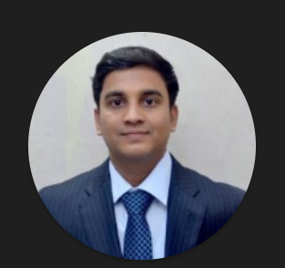
Test Manager
Profile
Overall experience of 15 years working with direct client-facing role in the UK Region. Area of expertise in Test delivery management and leading test teams in large engagements. Have excellent leadership stakeholder and Delivery management skills.
Qualifications & Certification
Engagement Manager Level 1
Bachelor in Engineering
Safe Scrum Master Certified
Azure Cloud Practioner
CSM Agile certification
ISTQB Foundation Certification
Connected Manager program by Harward University
Key Roles
Delivery & Project Management
Location
INDIA
Skills
Technologies / Applications
Industry Experience
Delivery and Project Management
Testing Methodologies Agile( Scrum and Kanban)
Defect Manager
Participate in planning meetings
Understanding the business need.
converting these business needs into developable products.
API Automation
Excellent communication
JIRA, Confluence
Microfocus ALM, Zephyr
Jenkins
Azure DevOps
Oracle, SQL
Unix/Windows
Telecom
Insurance
Retail
Postal Services
Recent Professional Experience
6 years of experience in testing Middleware and API Technologies using CI pipeline
End to End Automation using Ready API and Performance Testing using JMeter
Analysed Skilled at implementing testing techniques & strategies , Agile methodology, managed services, planning & Analysis
Have successfully managed the delivery of automation, performance and functional testing
Strong ability to manage complex and critical projects ( impacting 25+ systems) with a risk-based approach to deliver it to meet the aggressive timescale for time to market
Have an unwavering commitment to client service with the ability to build productive relationships, resolve complex issues and win consumer loyalty with good communication and interpersonal skills
Test lead and management experience with a variety of teams regularly deputised for the test manager. This includes some training
setting tasks, and deadlines and being the main point of contact at each phase in SDLC.
Taking ownership of each test deliverable and providing updates to senior management, whilst ensuring key stakeholders are kept informed and at ease during the wholesale process
Hands-on experience in integration, validation of specifications, designing traceability matrix, manual test case scripting, test case review, test case execution, defect & issue reporting and defect tracking & follow-up.
Contact Details

